Slide 1
DATABASE SYSTEM

Slide 2
Basic Concept
Data: Anything that can be recorded
Example: text, numbers, image, videos, speech
Database: Collection of related data
Example:
text and numbers(traditional database)
Audio, video, speech etc. (multimedia database)
Super market items (Realtime database)
Historical data(Dataware houses)

Slide 3
Continued…..
DB
Set of program that manage a database
Define(data), construct a DB and manipulates it
DBMS
DB+DBMS
DBS

Slide 4
Earlier Database System and its limitations
Data redundancy and inconsistency
Multiple file formats, duplication of information in different files
Difficulty in accessing data
Need to write a new program to carry out each new task
Integrity problems
Integrity constraints (e.g. account balance > 0) become part of program code
Data isolation
multiple files and formats
Atomicity of updates
Transaction failure may leads to an inconsistent state.

Slide 5
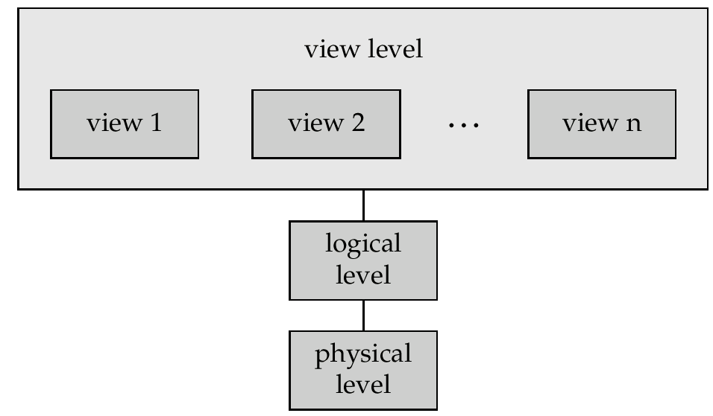
Structure of a Database System

Slide 6
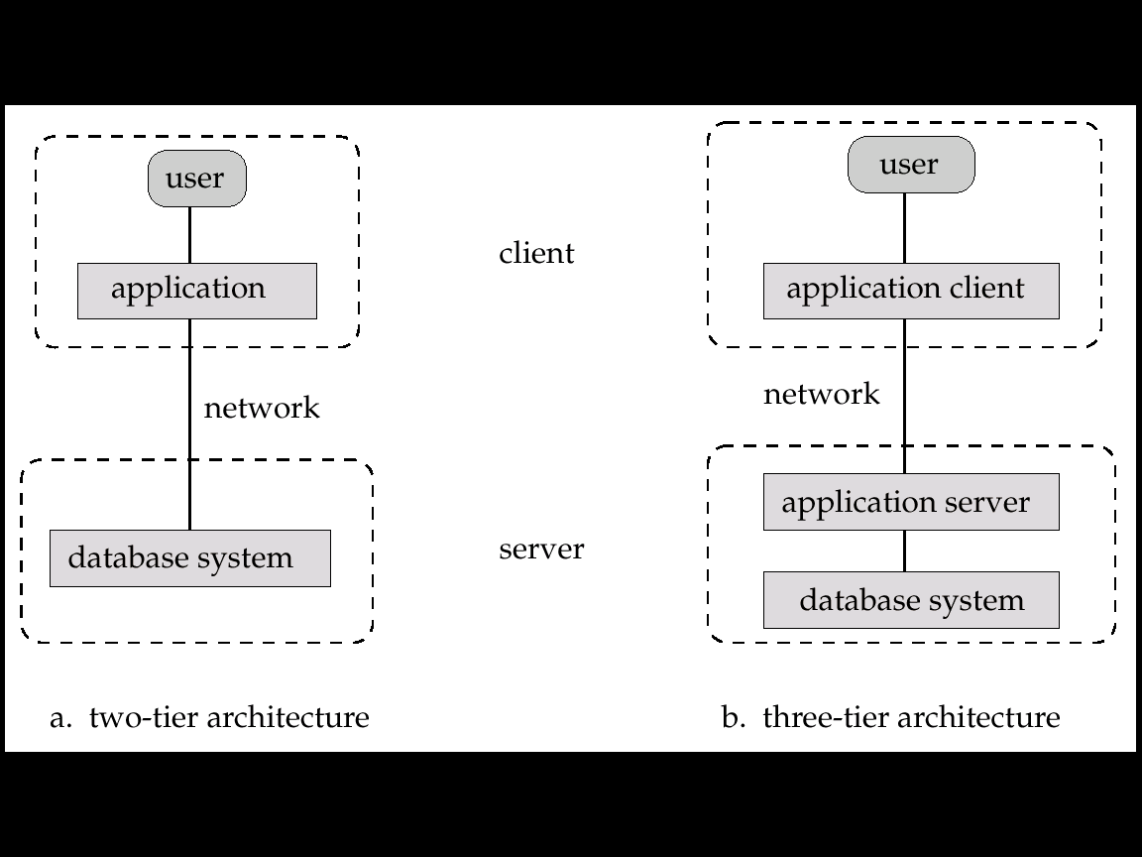
Different Levels of Architecture
Two-tier architecture: E.g. client programs using ODBC/JDBC to communicate with a database
Three-tier architecture: E.g. web-based applications, and applications built using “middleware”

Slide 7
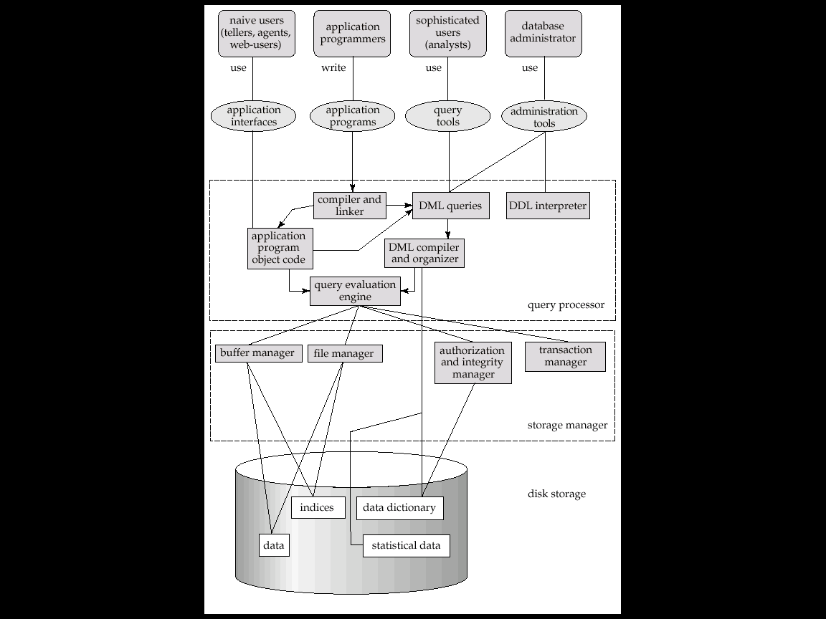
Overall Structure of a Database System

Slide 8
Users
Application programmers: interact with system through DML calls
Sophisticated users: form requests in a database query language
Specialized users: write specialized database applications that do not fit into the traditional data processing framework
Naïve users: invoke one of the permanent application programs that have been written previously
DBA: Define schema, responsible for storage and maintenance, different level of accessibility to users, observe performance and integrity constraints

Slide 9
Schemas and Instances
Schema describes the logical structure of the database
For Example: the database consists of information about a set of customers and accounts and the relationship between them)
Physical schema: database design at the physical level
Logical schema: database design at the logical level
Instance – the actual content of the database at a particular point in time
Analogous to the value of a variable
Physical Data Independence – the ability to modify the physical schema without changing the logical schema
Applications depend on the logical schema
In general, the interfaces between the various levels and components should be well defined so that changes in some parts do not seriously influence others.

Slide 10
DDL
Specification notation for defining the database schema
E.g. create table account ( account-number char(10), balance integer)
DDL compiler generates a set of tables stored in a data dictionary
Data dictionary contains metadata (i.e., data about data)
database schema
Data storage and definition language
language in which the storage structure and access methods used by the database system are specified
Usually an extension of the data definition language

Slide 11
DML
This is a language used for accessing and manipulating the data organized by the appropriate data model
DML also known as query language
Two classes of languages
Procedural – user specifies what data is required and how to get those data
Nonprocedural – user specifies what data is required without specifying how to get those data
SQL is the most widely used query language

Slide 12
SQL
SQL: widely used non-procedural language
find the balances of all accounts held by the customer with customer-id 192-83-7465 select account.balance from depositor, account where depositor.customer-id = ‘192-83-7465’ and depositor.account-number = account.account-number
Application programs generally access databases through one of
Language extensions to allow embedded SQL
Application program interface (e.g. ODBC/JDBC) which allow SQL queries to be sent to a database

Slide 13
Transaction
A transaction is a collection of operations that performs a single logical function in a database application
Transaction-management component ensures that the database remains in a consistent (correct) state despite system failures (e.g., power failures and operating system crashes) and transaction failures.
Concurrency-control manager controls the interaction among the concurrent transactions, to ensure the consistency of the database.

